Slide 1


Credit Risk Analysis
Dataset : credit_risk

Slide 2

About Me
As a final year Information Systems student at Universitas Terbuka and a passionate Data Analyst, I specialize in leveraging technology to drive business efficiency. I thrive on transforming raw data into clear, actionable insights that guide decision making.
My academic background has provided me with a robust foundation in data processing, visualization, and analytical tools. To further strengthen my practical skills, I successfully completed an intensive Data Analysis Bootcamp at Dibimbing. Through this program, I gained hands-on experience working with real-world data, integrating data across multiple platforms, and applying statistical methodologies such as clustering and ETL processes.

Slide 3











Education & Experience
Education
Work Experience
2022 - 2028
2024 - Now
Information System
Assistant Cook
Terbuka University
Yummy Corp
January 2026 - August 2026
2023 - 2024
Bootcamp Data Analyst
Assistant Cook
Dibimbing
BKB Restaurant
Skills :

Slide 4
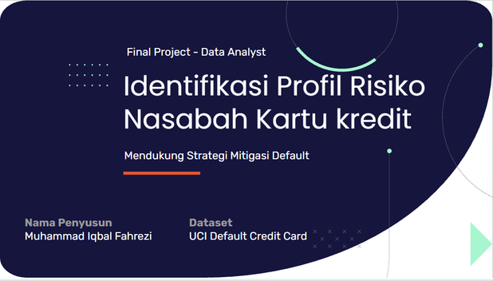

Project Overview
Final Project Dibimbing
Background :
Methodology:
The Bank does not yet have a systematic approach to identifying customers at risk of default before it occurs, resulting in reactive mitigation measures that may increase credit losses.
Conduct 3 statistical hypothesis tests
Analyze the strongest predictors of default
Develop an interactive Power BI dashboard
Domain : Credit Analytics / Banking
Impact :
The Bank can better understand customer behavioral patterns and implement preventive measures to minimize potential credit losses.
Tools Used :

Slide 5
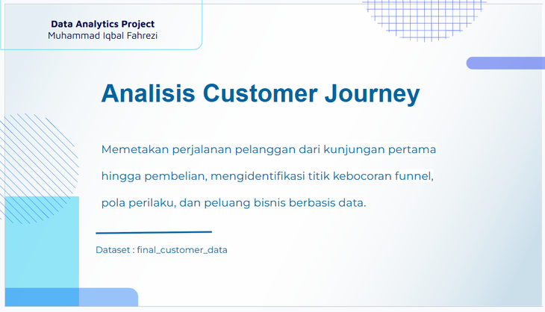
Project Overview
Customer Journey
Background :
Methodology:
Low Conversion Rate (36.7%): Heavily impacted by a 47.7% cart abandonment rate.
Funnel Bottleneck: The largest drop-off occurs between ‘Add to Cart’ to ‘Checkout’ (27.4%).
Retention Challenge: 83.3% of customers are one time visitors, despite visit frequency positively correlating with higher total spend.
Data driven promotional timing and channel selection
Resolving checkout funnel friction
Strategic resource allocation to high value categories
Domain : E-Commerce /Retail Analytics
Impact :
Cart Abadonment : Decreased via scheduled push notifications (19:00–21:00) and a streamlined checkout flow.
One Time Customers : Reduced through recurring re engagement programs.
Kids & Toys Category : Revenue growth driven by leveraging its high conversion rate (57.1%)
Ad Efficiency : Optimized ad spend through peak-hour targeting rather than day based allocation
Tools Used :

Slide 6

Table of Contents
Project Background | Objective, scope, and benefits
Business Problems | Business problems to be solved
Data Understanding | Data sources, quality, and structure
EDA | Analysis methods and key findings
Hypothesis Testing | Chi Square, Mann Whitney, Spearman
Dashboard and Visualizations | Power BI dashboard
Recomendations | Actionable business recommendations

Slide 7

Project Background
Background
Objectives
Results

Slide 8



Project Background
The banking industry faces a major challenge in managing credit risk, the possibility that borrowers fail to meet their payment obligations( default). Without an accurate assessment system, financial institutions risk significant losses from poorly targeted credit approvals.
Objectives
Benefits
Results
Identify default triggering factors
Build composite risk scoring system
Segment borrowers based on risk profile
Provied credit policy recommendations
More accurate credit decisions
More effectives customer portfolio monitoring
Minimize default losses
Dashboard Power BI (Overview, Risk Analysis, Segmentation)
Four well defined borrower segments
Statistically validated hypothesis tests as the foundation for business recommendations

Slide 9

Business Problems
6 Business Questions to Be Addressed

Slide 10
Business Problems
Business questions to be addressed through data analysis:
How is the default rate distributed, and which factors most strongly differentiate defaulting vs non defaulting borrowers ?
Which loan purposes carry the highest risk ?
Is loan grade significantly associated with default status ?
Does historical default history predict current default ?
Do income. interest rate, and DTI differ significantly between default status?
What are the profiles of the 4 borrower segments, and what policies are appropriate for each ?

Slide 11
Data Understanding
32.581
Original Data Rows
31.679
Rows After Cleaning
12
Variables
21.54%
Overall Default Rate
Dataset Variables
Numerik
person_age
Numerik
Borrower age (years)
person_income
Annual income
Kategorikal
Numerik
person_home_ownership
Home ownership status
person_emp_length
Employment length
Kategorikal
Ordinal
loan_intent
Loan purpose
loan_grade
Risk grade A - G
Numerik
Numerik
loan_amnt
Loan ammount
loan_int_rate
Interent rate %
Biner
Numerik
loan_status
0 = default | 1= non default
loan_percent_income
DTI
Kategorikal
Numerik
Credit history length
(years)
cb_person_default_on_file
Default history
cb_person_cred_hist_length

Slide 12

Data Cleaning
Duplicate
Missing Values
Outlier
Feature Engineering

Slide 13
Missing Values, Duplicate & Outlier
Duplicate | Missing Values
165 Baris | person_emp_length (895 row) Handle : Null values filled with the median interest rate calculated per loan_grade.
Duplicate dihapus semuanya | loan_int_rate (3.116 row) Handle : Missing values filled with the overall median of the person_emp_length column.
Outlier | Handle
person_age Max : 144 tahun Unrealistic for a borrower | Remove age > 100
person_emp_length Max : 123 tahun Impossible to work > 60 years | Remove emp_length >60

Slide 14






7 Feature Engineering
age_group
Young (<25), Adult (26-35), Middle Aged
(36-50), Senior (>50)
income_group
Low (<$30k), Medium ($30k-60k),
High ($60k-100k), Very High (>$100k)
loan_amnt_group
Small (<$5k), Medium ($5k-15k),
Large ($15k-25k), Very Large (>$25k)
dti_category
Very Low (<10%), Low (10-20%),
Moderate (20-35%), High (>35%).
loan_grade_num
A=1, B=2, C=3, D=4, E=5, F=6, G=7
risk_score (0-100)
Grade 40% + DTI 30% +
Interest Rate 20% + Default History 10%

Slide 15

7 Feature Engineering
risk_category
Low (<25): 10%, Moderate (25-50): 37%,
High (50-70): 71%, Very High
(>70) : 91%

Slide 16

Data Analysis Process
Key Finding Summary
EDA & Insight
Hypothesis Testing

Slide 17






Key Finding Summary
21.54%
Overall Default Rate
$306M
Total Portfolio
6/6
Significant Hypothesis
4
Borrower Segments
DTI is Strongest Predictor
The debt to income ratio is the strongest predictor after loan grade.
DTI>35% = Danger Zone
Borrowers with DTI above 35% have a default rate of 71%.
Debtconsolidation: Highest Risk
Has the highest default rate at 28.3% comnpared to Venture at 14.6%
K Means Segmentation Based Credit Policy
Segments A-B receive expedited approval, sgements C-D require mandatory review.
Rent Status: Highest Risk
Borrowers with Rent status have a default rate of 31%. Notably, Mortgage borrowers have a default rate of only 12%.
Non Default Income is Higher
Non default borrowers have a median income 0f $60,000 vs $42,000 for defaulting borrowers

Slide 18
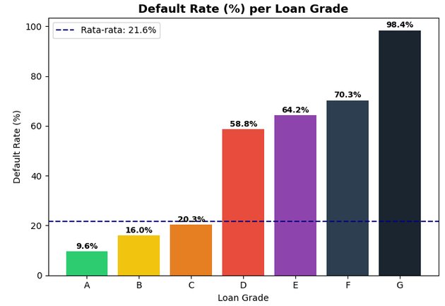
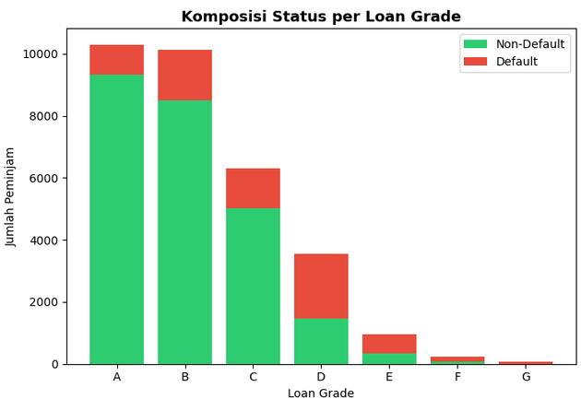
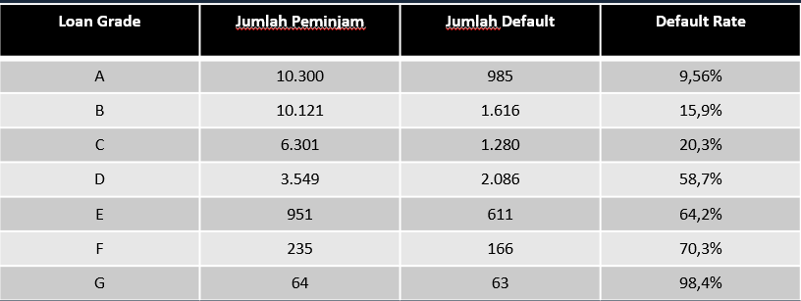
EDA Default Rate by Loan Grade
Insight :
There is an extreme jump between Grade C and Grade D, from 20.3% to 58.8%, signaling a drastic decline in borrower quality.
Grade D and below require greater deep investigation, as the risk carry has entered the extreme category.

Slide 19
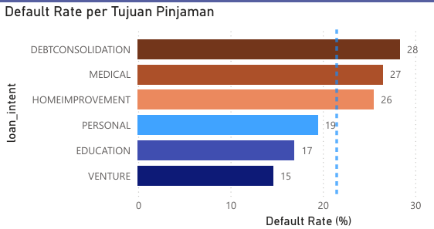
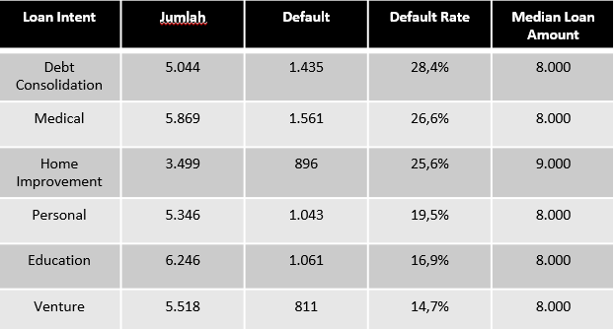
EDA Default Rate by Intent
Insight :
Debt consolidation is the riskiest intent (28.3%). Borrowers taking loans to repay other debts are already in a financially critical condition
The loan median is nearly identical across all categories ($8,000-$9,000), meaning differences in default rates across loan purposes are not driven by loan size, but by the distinct financial characteristics of borrowers with different intents.
Debt consolidation and medical loan applicants require stricter borrower profile reviews, as their financial conditions are more vulnerable.

Slide 20
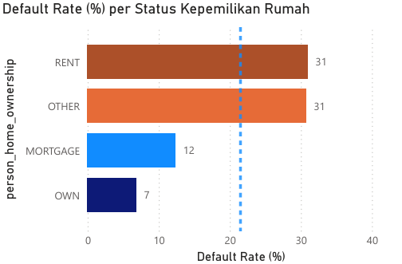
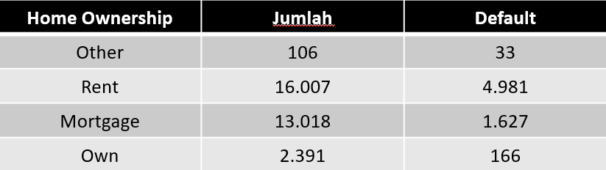
EDA Home Ownership
Insight :
Mortgage is the most interesting finding. Borrowers currently paying a mortgage have a default rate below the average (21.5%), as they have already been pre screened by the credit system.
Renters represent 50.7% of all borrowers, half the loan portfolio is held by the group with the highest default rate.
Rental borrowers should be evaluated more strictly, while mortgage borrowers can be treated with more flexibility.

Slide 21
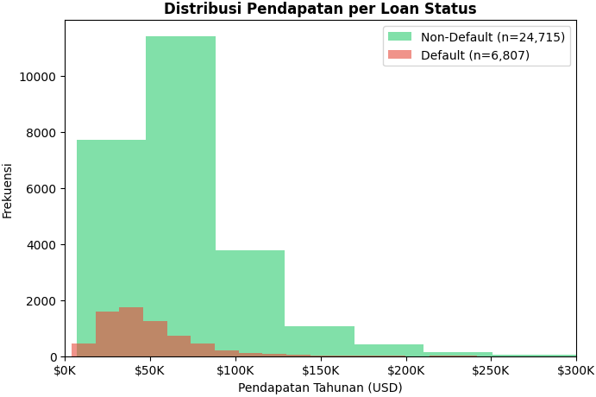
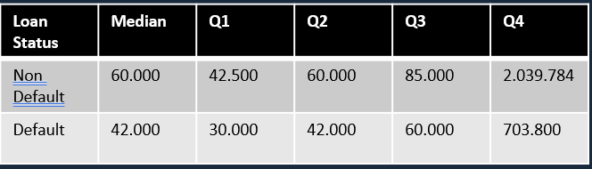
EDA Income vs Loan Status
Insight :
Even the lowest income non default borrowers have higher income than the lowest income defaulting borrowers.
There is significant overlap: half of non-default borrowers have income below $60,000, while a quarter of defaulting borrowers earn above $60,000 (Q3 default is approximately Q2 non default).
Income alone is insufficient as a credit policy consideration. Income must always be evaluated relative to the loan amount requested.

Slide 22
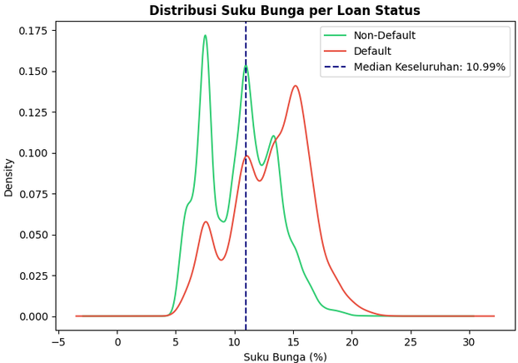
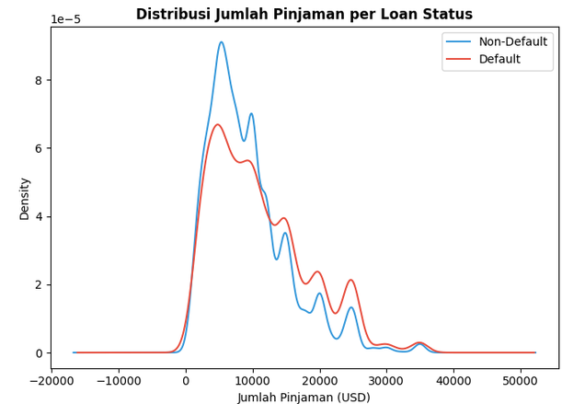
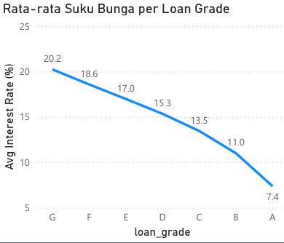
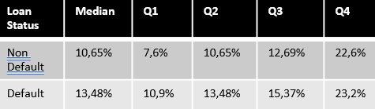
EDA Distribusi Suku Bunga & Jumlah Pinjaman vs Loan Status
Insight :
The entire interest rate distribution for defaulting borrowers shifts consistently to the right. Even the lowest rate among defaulting borrowers is roughly equal to the median rate of non-default borrowers.
Default loan amounts are slightly higher, but interest rates show a much sharper contrast. This means the absolute loan amount is not a strong default predictor, what matters is not how large the loan is, but how large it is relative to income (DTI).
An interest rate above 13% can serve as an early warning signal. Borrowers assigned a rate above this threshold require closer monitoring, as they carry above average risk.

Slide 23
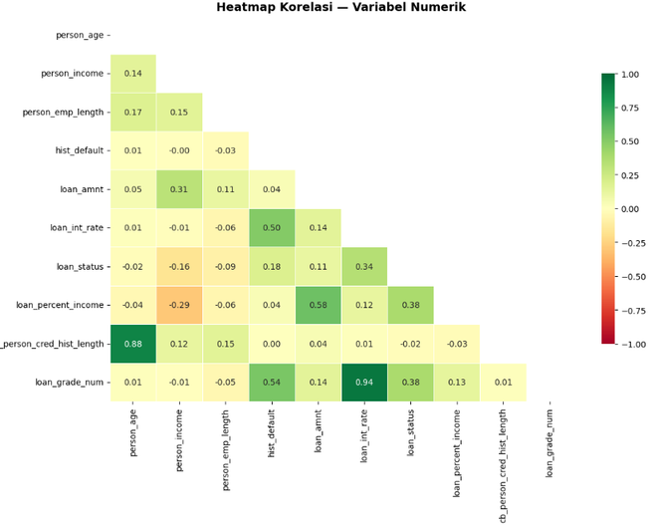
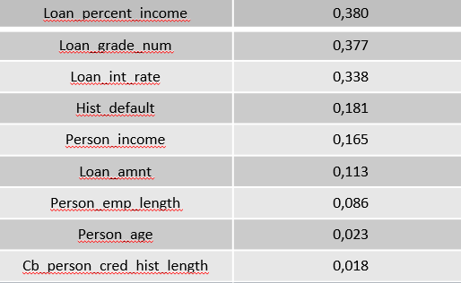
EDA Heatmap Korelasi dengan Loan Status
Insight :
loan_percent_income (DTI) has the strongest correlation with default, as DTI reflects actual repayment capacity.
The top three variables (DTI, grade, interest rate) are nearly equal in strength, with correlations of 0.33-0.38. Credit risk isn't driven by a single isolated variable; a sound predictive model must integrate all three metrics for an accurate assessment.
hist_default (historical default record) ranks fourth. Its predictive strength is meaningful, past default history can indicate future default, though it is not a guaranteed indicator.

Slide 24
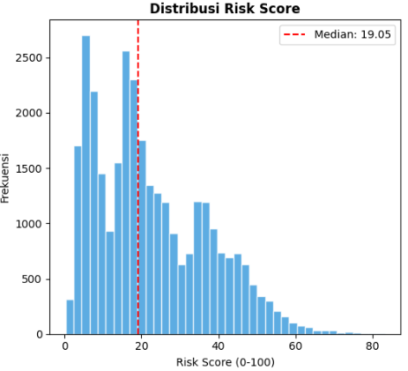
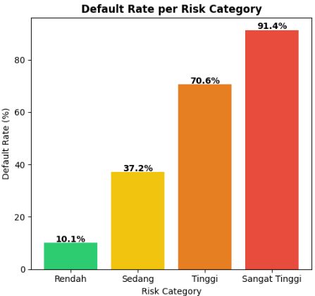
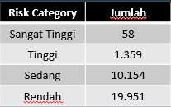
EDA Risk Score Distribution
Insight :
Most borrowers fall into the low risk category with scores below 25, creating a heavily left skewed distribution that reflects a portfolio dominated by strong credit profiles.
risk_score can be implemented as an automated scoring tool. When a new borrower applies for a loan, the system calculates four components (credit grade, DTI, interest rate, and default history) and generates a score between 0 and 100. It then determines the applicable policy.
Low = fast processing
Medium = standard review
High = requires collateral and an advanced review
Very High = reject or offer an alternative product

Slide 25
Hypothesis Testing
H1 | H2 | H3 | H5 | H4 | H6
loan grade vs loan status | person_income vs loan stat | loan_int_rate vs loan_status | cb_person_default vs loan_status | loan_intent vs loan_amnt | loan_percent_income vs loan_status
Grade is significantly associated The grading system is validated as a predictor | Non default median income is significantly higher than that of defaulting borrowers | Interest rate is positively correlated with default. | Loan distribution differs significantly across loan purposes. Intent is significant, but the practical difference is small. | Default history is correlated with loan_status. Borrowers with history (Y) have a 37.5% default rate, versus 18% for those without (N). | DTI of defaulting borrowers (24%) is nearly twice that of non default borrowers (13%).

Slide 26
Borrower Segmentation (K-Means)
Segment A
Prime
Segment B
Standard
Segment C
Subprime
Segment D
High Risk
14.215
44,7% of total
Default
7,84%
Income
$56k
Loan
$6.300
Bunga
8,49%
DTI
12%
3.439
10,8% of total
Default
18,3%
Income
$60k
Loan
$8.400
Bunga
10,9%
DTI
14%
7.662
24,1% of total
Default
35,8%
Income
$52k
Loan
$7.000
Bunga
14,2%
DTI
14%
6.363
20,9 of total
Default
37,6%
Income
$60k
Loan
$17.000
Bunga
11,4%
DTI
29%

Slide 27

Dashboard
Overview
Risk Analysis
Borrower Segmentation

Slide 28

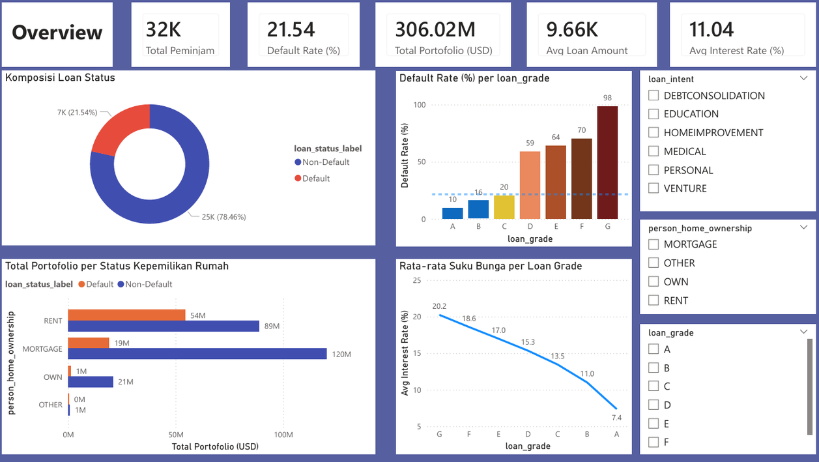
Dashboard Power BI
Overview
Overview
5 KPI Card : Peminjam, Default Rate, Portofolio, Avg Loan, Avg Rate
Donut Chart : Default vs Non default composition
Column Chart : Default rate per Grade A - G
Line Chart : Avg intereset rate per grade
Bar chart : Portfolio per Home Ownership
Slicer : Grade, Intent, Home Ownership

Slide 29

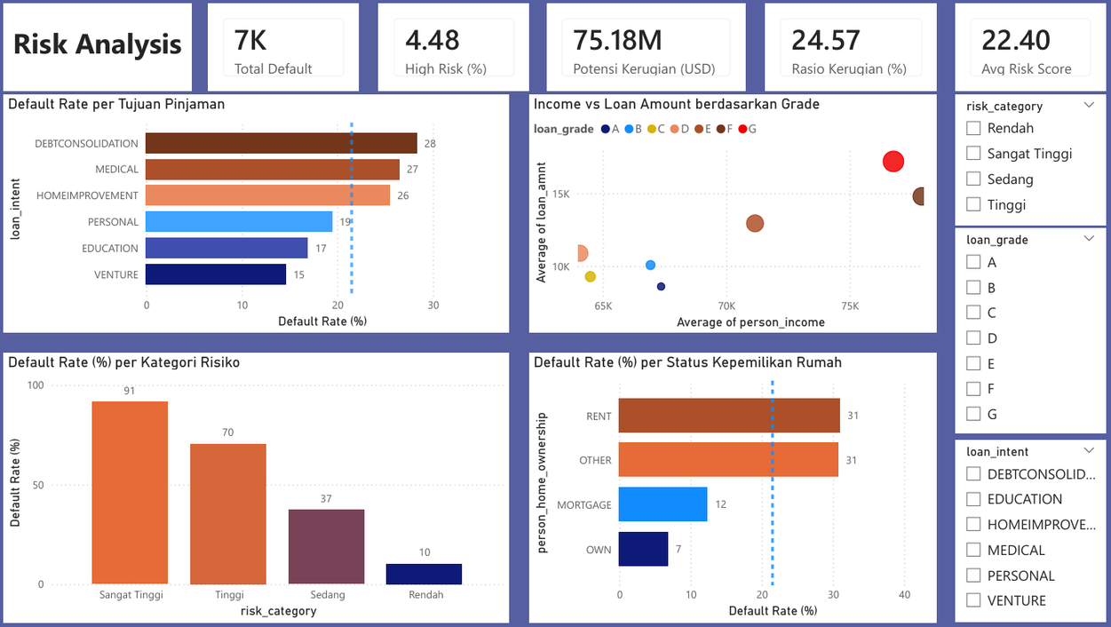
Dashboard Power BI
Risk Analysis
Risk Analysis
5 KPI Card : Total default, High Risk%, Potential Losses, Loss Ratio, Avg Risk Score
Bar Chart : Default Rate per loan intent
Column Chart : Defaut rate per risk category
Scatter Chart : Income vs loan amount per grade
Bar chart : Rate per Home Ownership
Slicer : Risk Category, Grade,, Intent

Slide 30

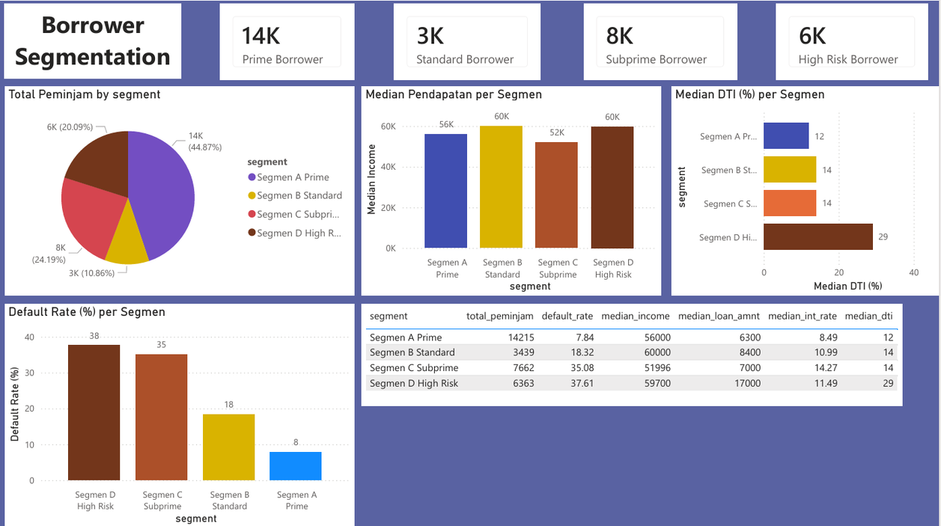
Dashboard Power BI
Borrower Segmentation
Borrower Segmentation
4 KPI Card : Count per segmen
Pie Chart : Distribution 4 K Means Segment
Column Chart : Defaut rate per segment
Bar Chart : Median DTI per segmen
Tabel : Full segment profiles

Slide 31

Recommendations
Default History Check
Cap Maximum DTI at <35%
Segmentation Based Policy

Slide 32
Recommendation
Segmen A
Prime
Segmen B
Standard
Segmen C
Subprime
Segmen D
High Risk
Auto approve with fast processing (<24 hours)
Offer competitive interest rates and high credits limits
vIP Program: rewards & cross sell premium products
Light monitoring
Standard approval with normal SLA
Verify income and credit history
Engagement program to build customer loyalty
Quarterly monitoring
Cap loan amount
Collateral or guarantee required
Interest rate adjusted to risk profile
Send loan payment reminder notifications
Monthly monitoring
Mandatory senior credit committee review
Consider rejection or micro loan
If approved, applyu very strict limits and closer monitoring

Slide 33


Thank you for your attention
farezfahrezi07653@gmail.com
Iqbal Fahrezi

